Slide 1
Word representation
Đào Việt Duy – 51603070
Nguyễn Duy Hàn Lâm – 196005004
Instructor: Thầy Lê Anh Cường

Slide 2
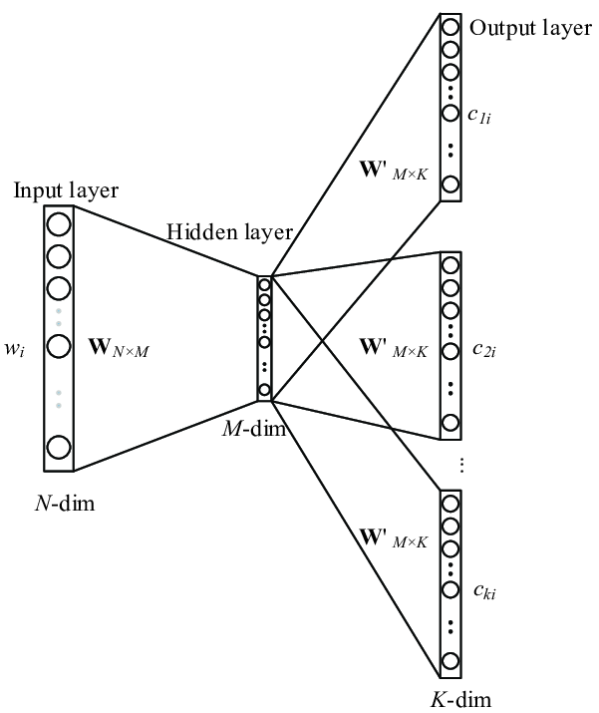
Skip-gram
Từ ngữ cảnh
Từ trung tâm
Từ ngữ cảnh
Từ ngữ cảnh

Slide 3
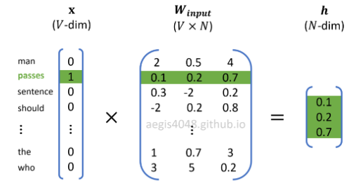
Skip-gram (Feedforward)

Slide 4
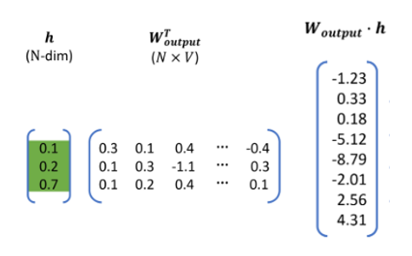
Skip-gram (Feedforward)

Slide 5
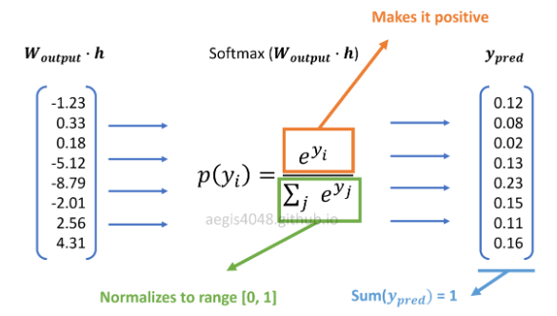
Skip-gram (Feedforward)

Slide 6
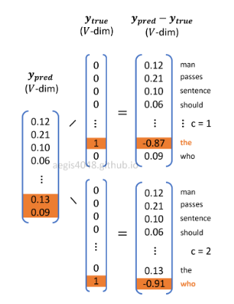

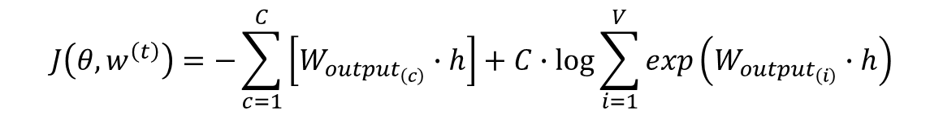
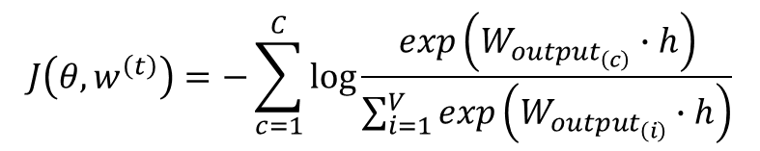
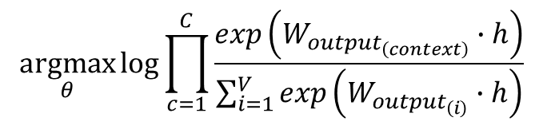
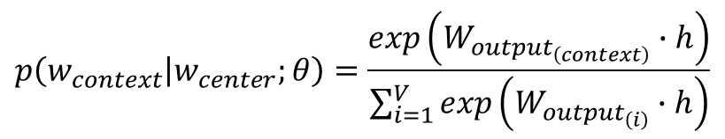
Skip-gram (Feedforward)
$$\underset{θ}{argmax}{\log{p\left(w_{1},w_{2},…,w_{C} | w_{center};θ\right)}}$$
$$p\left(w_{context} | w_{center};θ\right)=\frac{exp\left(W_{{output}_{\left(context\right)}}∙h\right)}{\sum_{i=1}^{V}{exp\left(W_{{output}_{\left(i\right)}}∙h\right)}}$$
$$\underset{θ}{argmax}{\log{\prod_{c=1}^{C}{\frac{exp\left(W_{{output}_{\left(context\right)}}∙h\right)}{\sum_{i=1}^{V}{exp\left(W_{{output}_{\left(i\right)}}∙h\right)}}}}}$$
$$J\left(θ,w^{\left(t\right)}\right)=−\sum_{c=1}^{C}{\log{\frac{exp\left(W_{{output}_{\left(c\right)}}∙h\right)}{\sum_{i=1}^{V}{exp\left(W_{{output}_{\left(i\right)}}∙h\right)}}}}$$
$$J\left(θ,w^{\left(t\right)}\right)=−\sum_{c=1}^{C}{\left[W_{{output}_{\left(c\right)}}∙h\right]}+C∙\log{\sum_{i=1}^{V}{exp\left(W_{{output}_{\left(i\right)}}∙h\right)}}$$

Slide 7
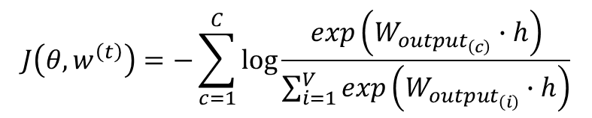
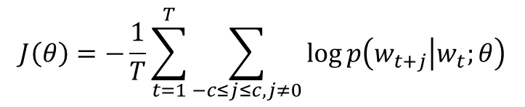
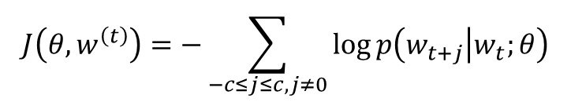
Skip-gram (Feedforward)
$$J\left(θ,w^{\left(t\right)}\right)=−\sum_{c=1}^{C}{\log{\frac{exp\left(W_{{output}_{\left(c\right)}}∙h\right)}{\sum_{i=1}^{V}{exp\left(W_{{output}_{\left(i\right)}}∙h\right)}}}}$$
$$J\left(θ,w^{\left(t\right)}\right)=−\sum_{−c≤j≤c,j≠0}{\log{p\left(w_{t+j} | w_{t};θ\right)}}$$
Tổng quát hóa cho T từ:
$$J\left(θ\right)=−\frac{1}{T}\sum_{t=1}^{T}{\sum_{−c≤j≤c,j≠0}{\log{p\left(w_{t+j} | w_{t};θ\right)}}}$$

Slide 8
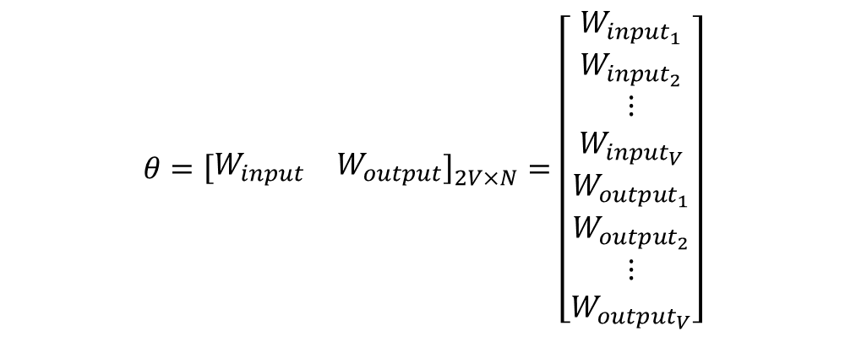
Skip-gram (Backpropagation)
$$θ={\left[\begin{matrix}W_{input} & W_{output}\end{matrix}\right]}_{2V×N}=\left[\begin{matrix}\begin{matrix}W_{{input}_{1}} \\ W_{{input}_{2}}\end{matrix} \\ \begin{matrix}⋮ \\ W_{{input}_{V}}\end{matrix} \\ \begin{matrix}W_{{output}_{1}} \\ W_{{output}_{2}} \\ \begin{matrix}⋮ \\ W_{{output}_{V}}\end{matrix}\end{matrix}\end{matrix}\right]$$

Slide 9
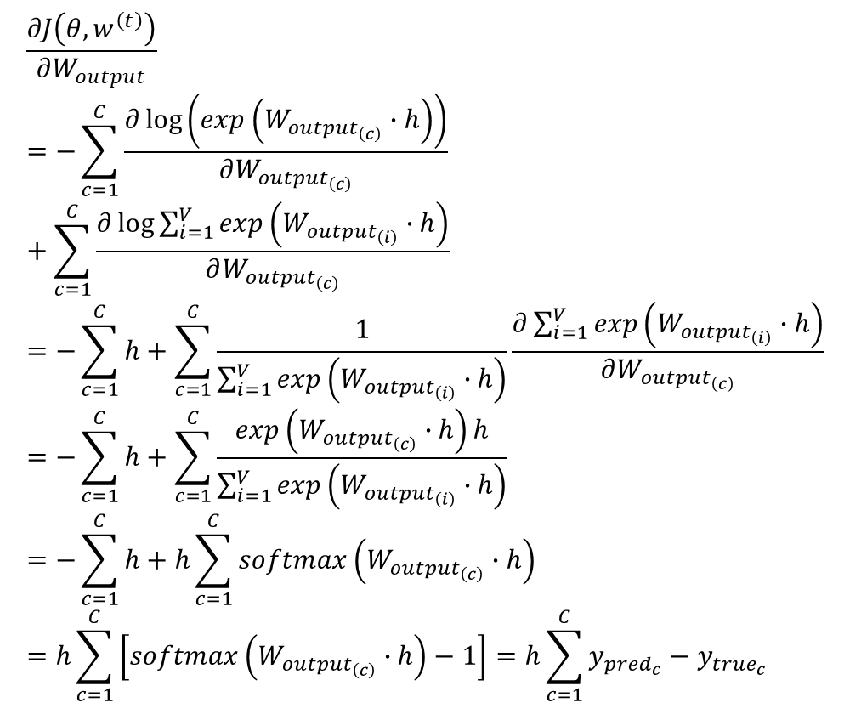
Skip-gram (Backpropagation)
$$\frac{∂J\left(θ,w^{\left(t\right)}\right)}{∂W_{output}}=−\sum_{c=1}^{C}{\frac{∂\log\left(exp\left(W_{{output}_{\left(c\right)}}∙h\right)\right)}{∂W_{{output}_{\left(c\right)}}}}+\sum_{c=1}^{C}{\frac{∂\log{\sum_{i=1}^{V}{exp\left(W_{{output}_{\left(i\right)}}∙h\right)}}}{∂W_{{output}_{\left(c\right)}}}}=−\sum_{c=1}^{C}{h}+\sum_{c=1}^{C}{\frac{1}{\sum_{i=1}^{V}{exp\left(W_{{output}_{\left(i\right)}}∙h\right)}}\frac{∂\sum_{i=1}^{V}{exp\left(W_{{output}_{\left(i\right)}}∙h\right)}}{∂W_{{output}_{\left(c\right)}}}}=−\sum_{c=1}^{C}{h}+\sum_{c=1}^{C}{\frac{exp\left(W_{{output}_{\left(c\right)}}∙h\right)h}{\sum_{i=1}^{V}{exp\left(W_{{output}_{\left(i\right)}}∙h\right)}}}=−\sum_{c=1}^{C}{h}+h\sum_{c=1}^{C}{softmax\left(W_{{output}_{\left(c\right)}}∙h\right)}=h\sum_{c=1}^{C}{\left[softmax\left(W_{{output}_{\left(c\right)}}∙h\right)−1\right]}=h\sum_{c=1}^{C}{y_{{pred}_{c}}−y_{{true}_{c}}}$$

Slide 10
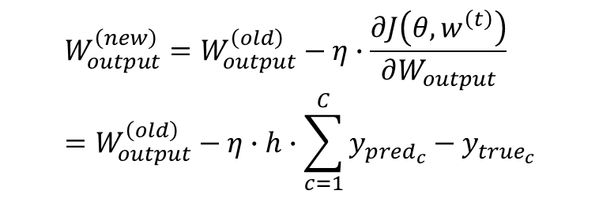
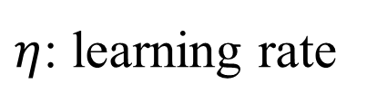
Skip-gram (Backpropagation)
$η$: learning rate
$$W_{output}^{\left(new\right)}=W_{output}^{\left(old\right)}−η∙\frac{∂J\left(θ,w^{\left(t\right)}\right)}{∂W_{output}}=W_{output}^{\left(old\right)}−η∙h∙\sum_{c=1}^{C}{y_{{pred}_{c}}−y_{{true}_{c}}}$$

Slide 11
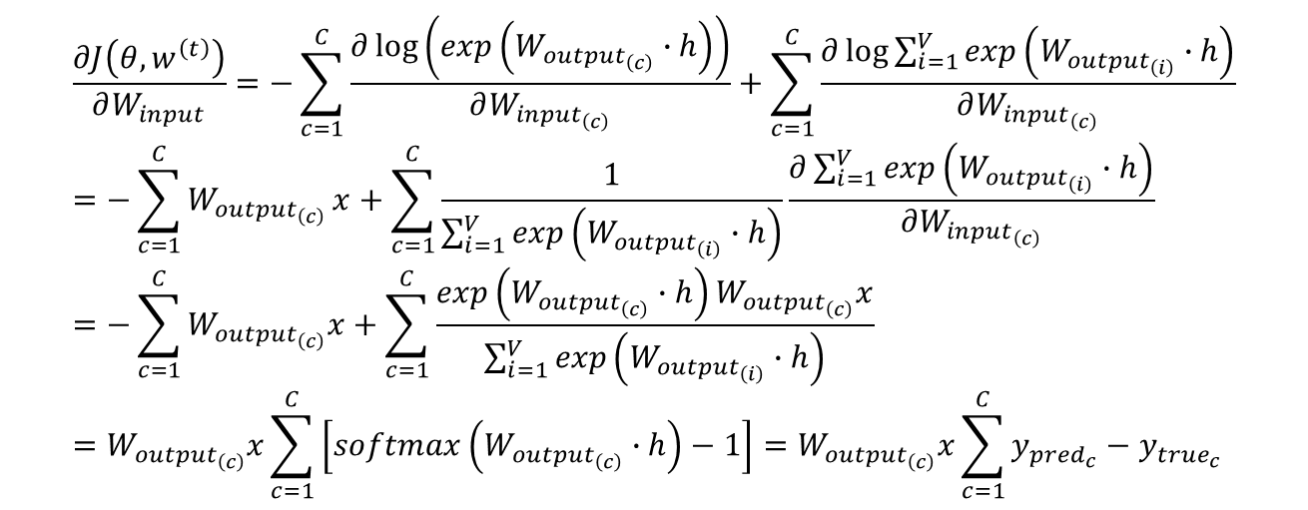
Skip-gram (Backpropagation)
$$\frac{∂J\left(θ,w^{\left(t\right)}\right)}{∂W_{input}}=−\sum_{c=1}^{C}{\frac{∂\log\left(exp\left(W_{{output}_{\left(c\right)}}∙h\right)\right)}{∂W_{{input}_{\left(c\right)}}}}+\sum_{c=1}^{C}{\frac{∂\log{\sum_{i=1}^{V}{exp\left(W_{{output}_{\left(i\right)}}∙h\right)}}}{∂W_{{input}_{\left(c\right)}}}}=−\sum_{c=1}^{C}{W_{{output}_{\left(c\right)}}}x+\sum_{c=1}^{C}{\frac{1}{\sum_{i=1}^{V}{exp\left(W_{{output}_{\left(i\right)}}∙h\right)}}\frac{∂\sum_{i=1}^{V}{exp\left(W_{{output}_{\left(i\right)}}∙h\right)}}{∂W_{{input}_{\left(c\right)}}}}=−\sum_{c=1}^{C}{W_{{output}_{\left(c\right)}}x}+\sum_{c=1}^{C}{\frac{exp\left(W_{{output}_{\left(c\right)}}∙h\right)W_{{output}_{\left(c\right)}}x}{\sum_{i=1}^{V}{exp\left(W_{{output}_{\left(i\right)}}∙h\right)}}}=W_{{output}_{\left(c\right)}}x\sum_{c=1}^{C}{\left[softmax\left(W_{{output}_{\left(c\right)}}∙h\right)−1\right]}=W_{{output}_{\left(c\right)}}x\sum_{c=1}^{C}{y_{{pred}_{c}}−y_{{true}_{c}}}$$

Slide 12
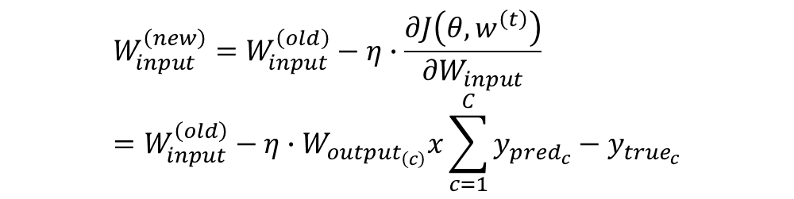
Skip-gram (Backpropagation)
$$W_{input}^{\left(new\right)}=W_{input}^{\left(old\right)}−η∙\frac{∂J\left(θ,w^{\left(t\right)}\right)}{∂W_{input}}=W_{input}^{\left(old\right)}−η∙W_{{output}_{\left(c\right)}}x\sum_{c=1}^{C}{y_{{pred}_{c}}−y_{{true}_{c}}}$$

Slide 13


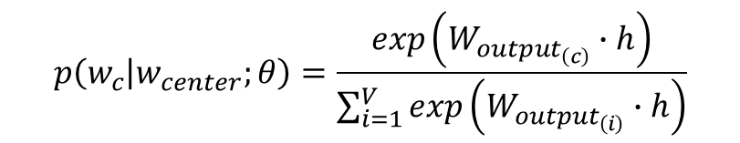
Skip-gram (Softmax problem)
$$p\left(w_{c} | w_{center};θ\right)=\frac{exp\left(W_{{output}_{\left(c\right)}}∙h\right)}{\sum_{i=1}^{V}{exp\left(W_{{output}_{\left(i\right)}}∙h\right)}}$$

Slide 14
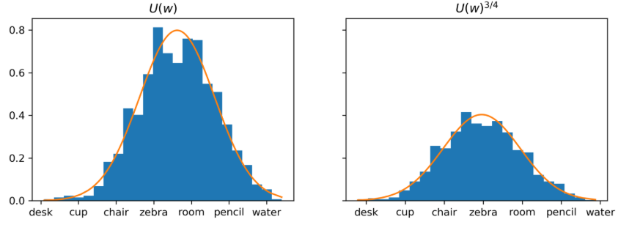
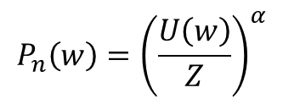
Skip-gram (Noise distribution)
$$P_{n}\left(w\right)={\left(\frac{U\left(w\right)}{Z}\right)}^{α}$$

Slide 15
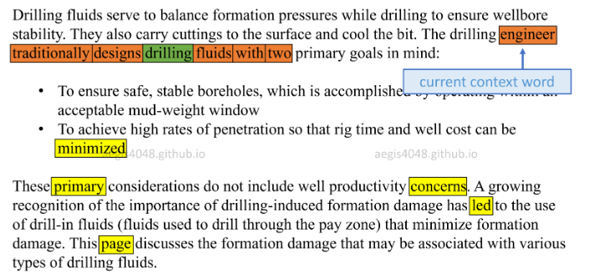




Skip-gram (Negative sampling - NS)
$$\left[\begin{matrix}\begin{matrix}Drill \\ fluid\end{matrix} \\ \begin{matrix}⋮ \\ engineer\end{matrix} \\ \begin{matrix}tradition \\ design \\ \begin{matrix}⋮ \\ of\end{matrix}\end{matrix}\end{matrix}\right]$$
$$\left[\begin{matrix}\begin{matrix}engineer \\ minimize\end{matrix} \\ primary \\ \begin{matrix}concern \\ led \\ page\end{matrix}\end{matrix}\right]$$
$$V$$
$$k samples+1$$

Slide 16
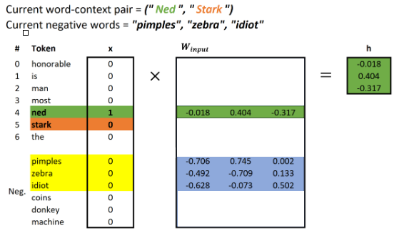

Skip-gram (NS - Forward)
$$k samples+1$$

Slide 17
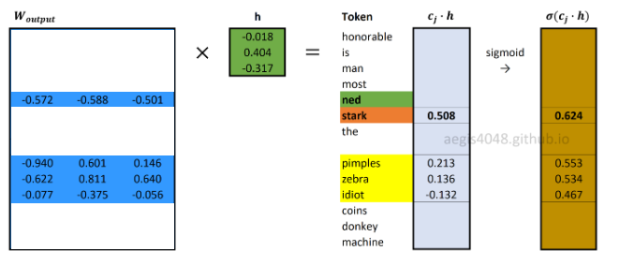
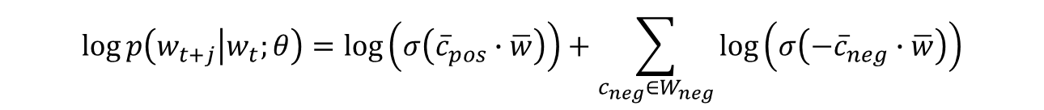
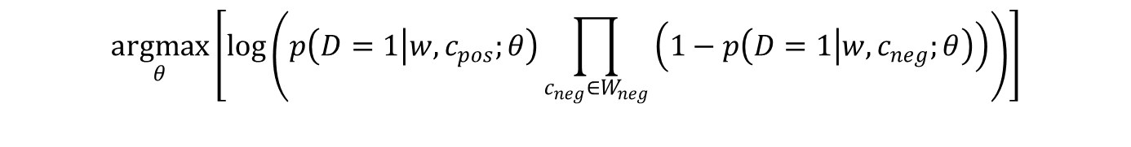
Skip-gram (NS - Forward)
$$\underset{θ}{argmax}\left[\log\left(p\left(D=1 | w,c_{pos};θ\right)\prod_{c_{neg}∈W_{neg}}{\left(1−p\left(D=1 | w,c_{neg};θ\right)\right)}\right)\right]$$
$$\log{p\left(w_{t+j} | w_{t};θ\right)}=\log\left(σ\left({\overline{c}}_{pos}∙\overline{w}\right)\right)+\sum_{c_{neg}∈W_{neg}}{\log\left(σ\left(−{\overline{c}}_{neg}∙\overline{w}\right)\right)}$$

Slide 18
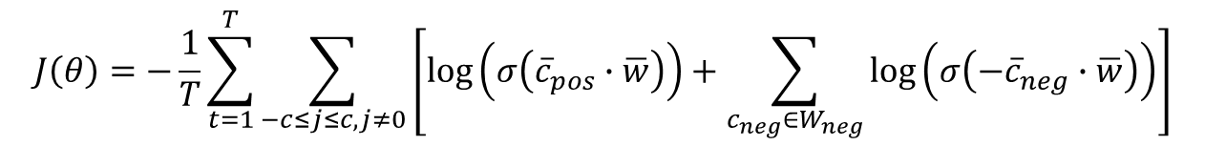
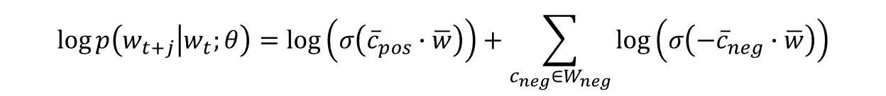
Skip-gram (NS - Forward)
$$\log{p\left(w_{t+j} | w_{t};θ\right)}=\log\left(σ\left({\overline{c}}_{pos}∙\overline{w}\right)\right)+\sum_{c_{neg}∈W_{neg}}{\log\left(σ\left(−{\overline{c}}_{neg}∙\overline{w}\right)\right)}$$
$$J\left(θ\right)=−\frac{1}{T}\sum_{t=1}^{T}{\sum_{−c≤j≤c,j≠0}{\left[\log\left(σ\left({\overline{c}}_{pos}∙\overline{w}\right)\right)+\sum_{c_{neg}∈W_{neg}}{\log\left(σ\left(−{\overline{c}}_{neg}∙\overline{w}\right)\right)}\right]}}$$

Slide 19
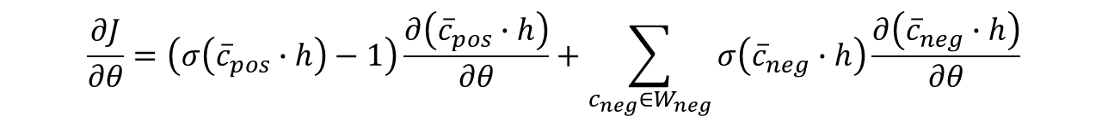
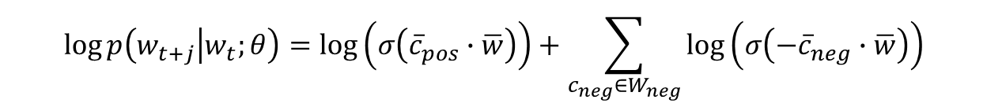
Skip-gram (NS - Backward)
$$\log{p\left(w_{t+j} | w_{t};θ\right)}=\log\left(σ\left({\overline{c}}_{pos}∙\overline{w}\right)\right)+\sum_{c_{neg}∈W_{neg}}{\log\left(σ\left(−{\overline{c}}_{neg}∙\overline{w}\right)\right)}$$
$$\frac{∂J}{∂θ}=\left(σ\left({\overline{c}}_{pos}∙h\right)−1\right)\frac{∂\left({\overline{c}}_{pos}∙h\right)}{∂θ}+\sum_{c_{neg}∈W_{neg}}{σ\left({\overline{c}}_{neg}∙h\right)\frac{∂\left({\overline{c}}_{neg}∙h\right)}{∂θ}}$$

Slide 20
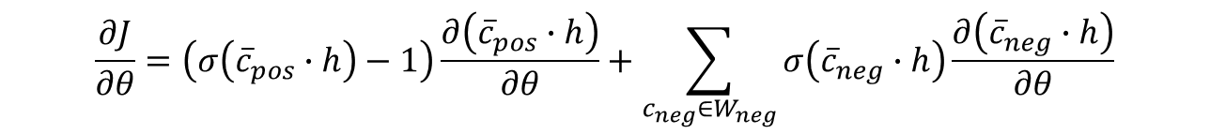
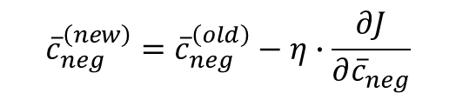
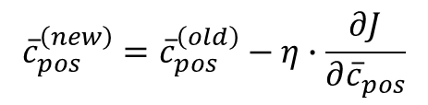
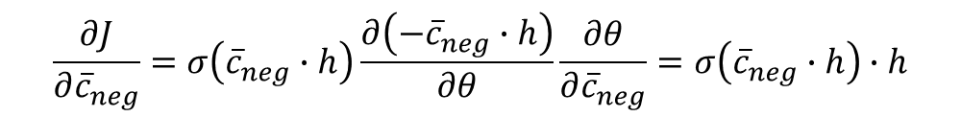
Skip-gram (NS – Backward - output)
$$\frac{∂J}{∂θ}=\left(σ\left({\overline{c}}_{pos}∙h\right)−1\right)\frac{∂\left({\overline{c}}_{pos}∙h\right)}{∂θ}+\sum_{c_{neg}∈W_{neg}}{σ\left({\overline{c}}_{neg}∙h\right)\frac{∂\left({\overline{c}}_{neg}∙h\right)}{∂θ}}$$
$$\frac{∂J}{∂{\overline{c}}_{pos}}=\left(σ\left({\overline{c}}_{pos}∙h\right)−1\right)\frac{∂\left({\overline{c}}_{pos}∙h\right)}{∂θ}\frac{∂θ}{∂{\overline{c}}_{pos}}=\left(σ\left({\overline{c}}_{pos}∙h\right)−1\right)∙h$$
$$\frac{∂J}{∂{\overline{c}}_{neg}}=σ\left({\overline{c}}_{neg}∙h\right)\frac{∂\left(−{\overline{c}}_{neg}∙h\right)}{∂θ}\frac{∂θ}{∂{\overline{c}}_{neg}}=σ\left({\overline{c}}_{neg}∙h\right)∙h$$
$${\overline{c}}_{pos}^{\left(new\right)}={\overline{c}}_{pos}^{\left(old\right)}−η∙\frac{∂J}{∂{\overline{c}}_{pos}}$$
$${\overline{c}}_{neg}^{\left(new\right)}={\overline{c}}_{neg}^{\left(old\right)}−η∙\frac{∂J}{∂{\overline{c}}_{neg}}$$

Slide 21
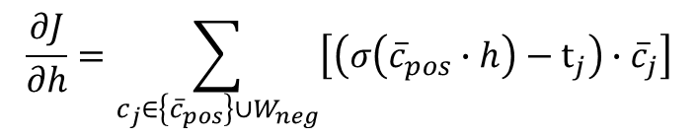
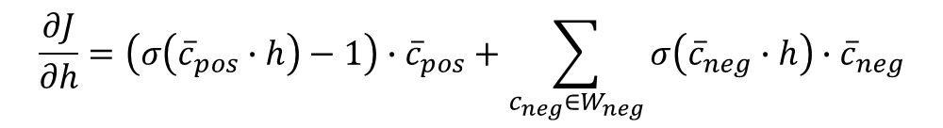
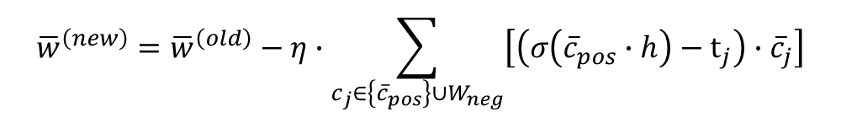

Skip-gram (NS – Backward - h)
$$\frac{∂J}{∂h}=\left(σ\left({\overline{c}}_{pos}∙h\right)−1\right)∙{\overline{c}}_{pos}+\sum_{c_{neg}∈W_{neg}}{σ\left({\overline{c}}_{neg}∙h\right)∙{\overline{c}}_{neg}}$$
$$\frac{∂J}{∂h}=\sum_{c_{j}∈\left\{{\overline{c}}_{pos}\right\}∪W_{neg}}{\left[\left(σ\left({\overline{c}}_{pos}∙h\right)−t_{j}\right)∙{\overline{c}}_{j}\right]}$$
Với $t_{j}=1$ khi $c_{j}$ là ${\overline{c}}_{pos}$ và $t_{j}=0$ khi $c_{j}∈W_{neg}$.
$${\overline{w}}^{\left(new\right)}={\overline{w}}^{\left(old\right)}−η∙\sum_{c_{j}∈\left\{{\overline{c}}_{pos}\right\}∪W_{neg}}{\left[\left(σ\left({\overline{c}}_{pos}∙h\right)−t_{j}\right)∙{\overline{c}}_{j}\right]}$$

Slide 22

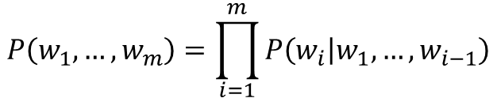
App: Language model
$$P\left(w_{1},…,w_{m}\right)=\prod_{i=1}^{m}{P\left(w_{i} | w_{1},…,w_{i−1}\right)}$$
Văn bản gốc
Dự đoán

Slide 23
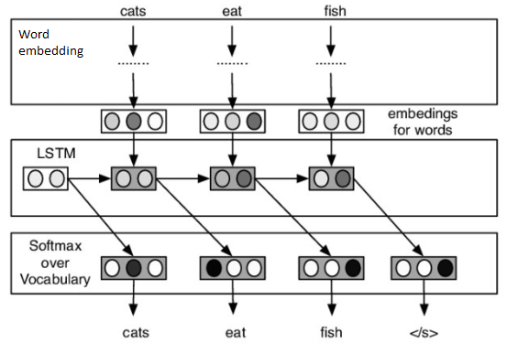
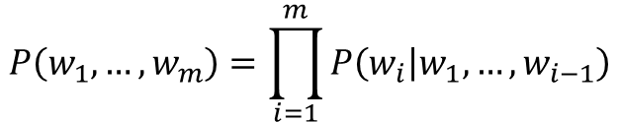
App: Language model
$$P\left(w_{1},…,w_{m}\right)=\prod_{i=1}^{m}{P\left(w_{i} | w_{1},…,w_{i−1}\right)}$$
Văn bản gốc
Dự đoán

Slide 24
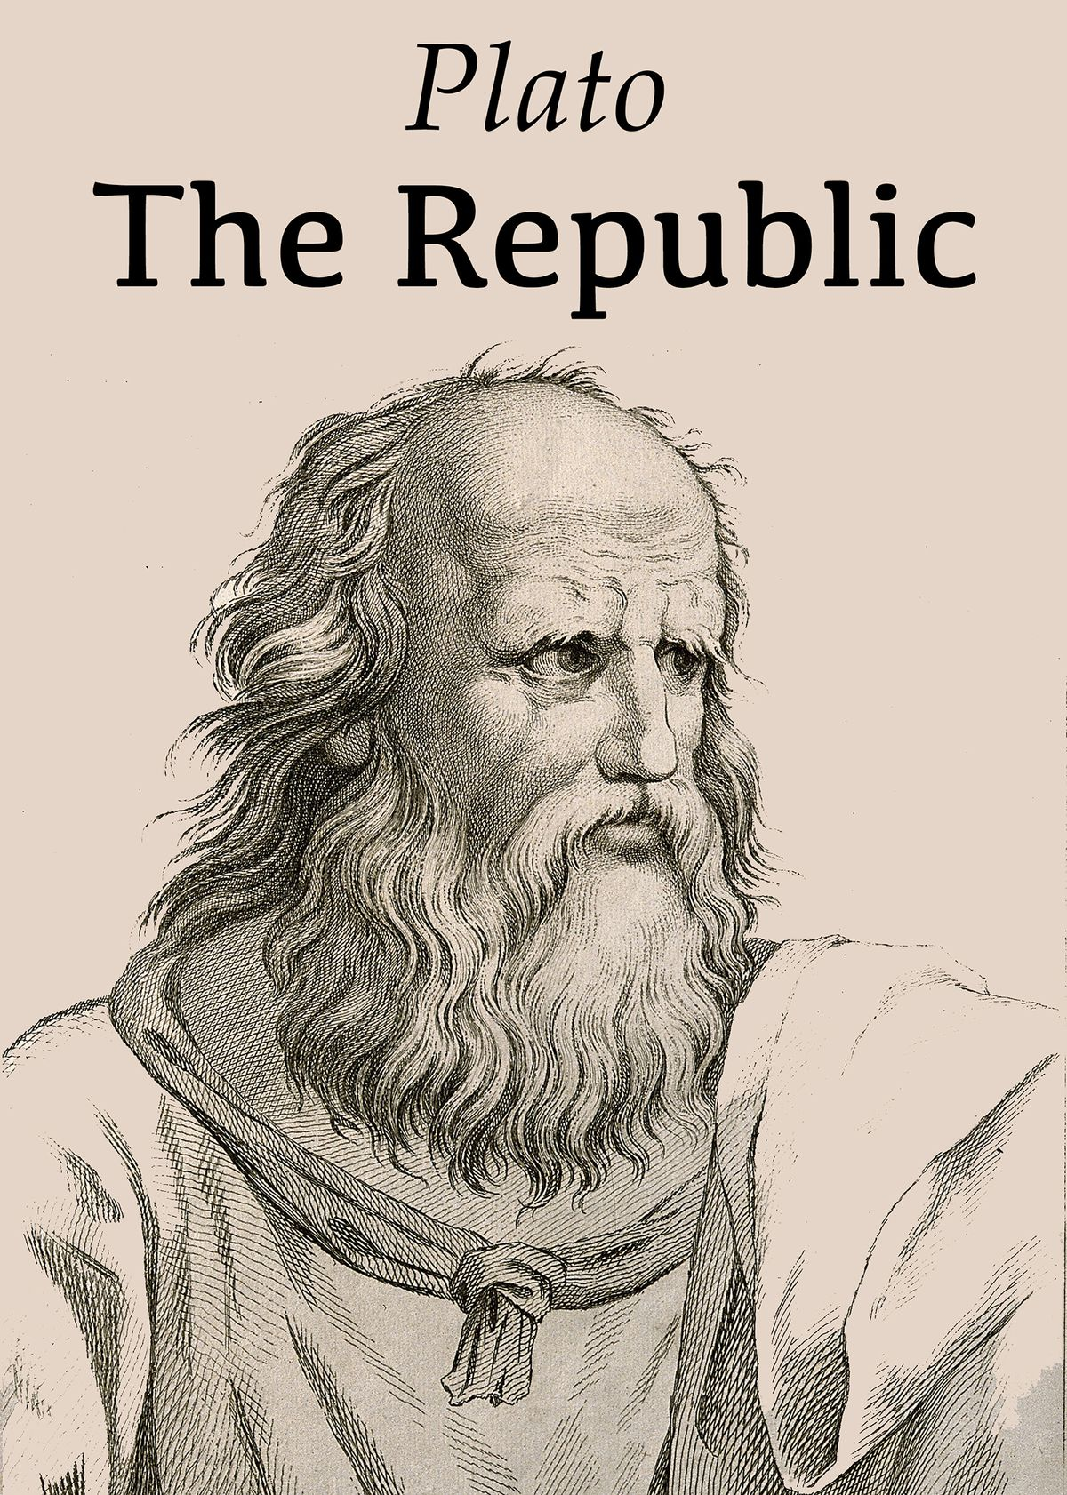
App: Language model (Data)

Slide 25
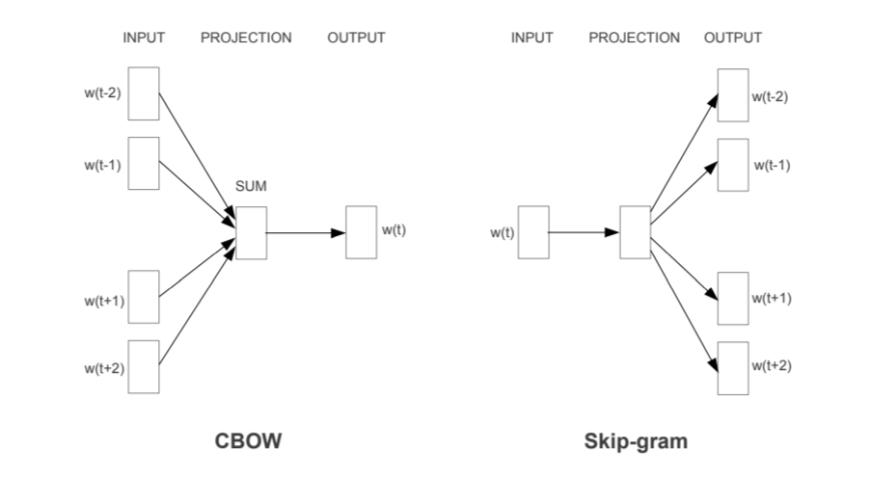
Cbow

Slide 26
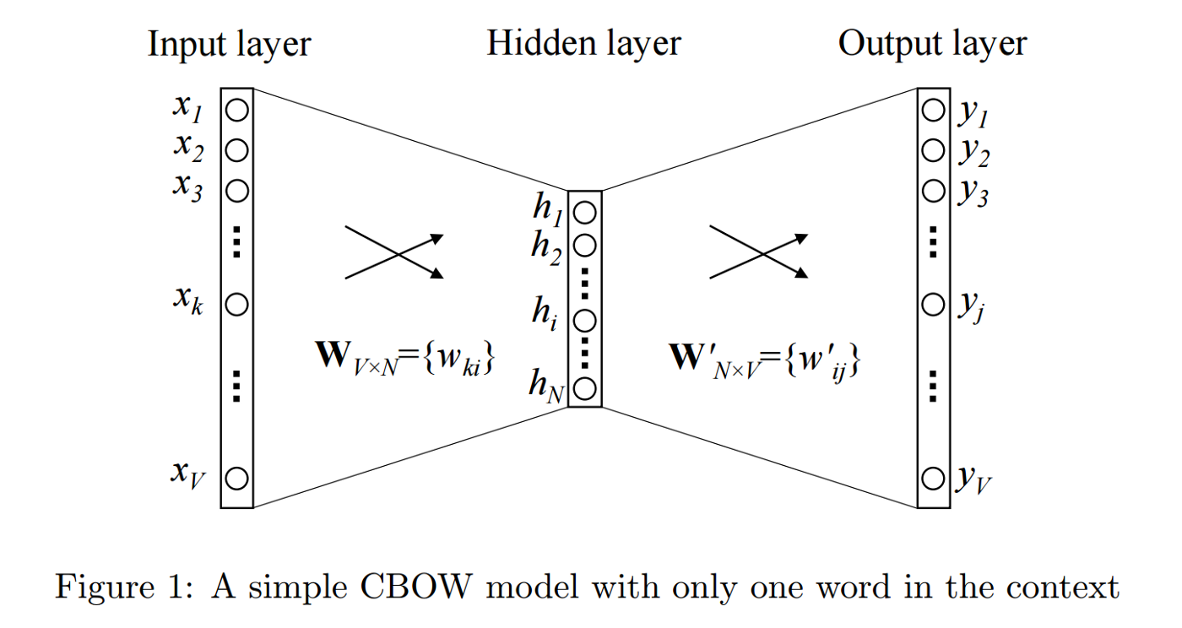
Cbow

Slide 27
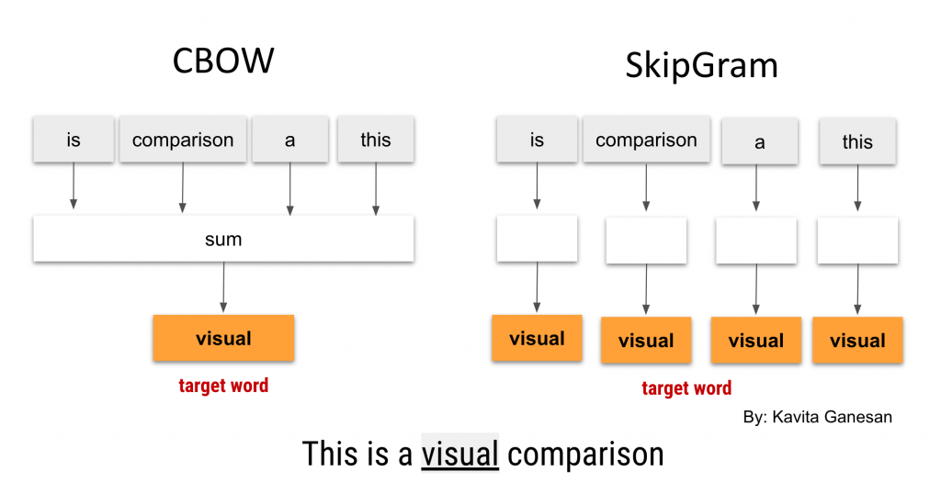
Cbow

Slide 28
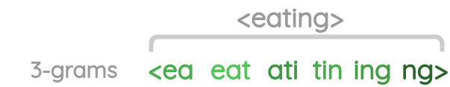
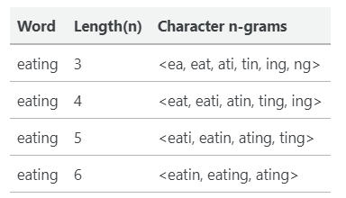
fastText

Slide 29

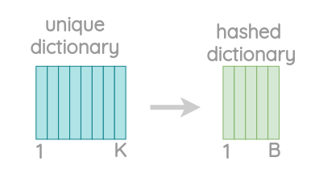
fastText
Hash dictionary
lovely – 123xx7
nice – 123xx7
good – 123xx8
nice – 123xx8
MAX_VOCAB_SIZE = 30000000
123xx9
nice – 123xx9

Slide 30

fastText
Đã sử dụng 75% hash dictionary
science
N = 3
Đã sử dụng 75% hash dictionary
science
N = 4
MAX_VOCAB_SIZE = 30000000
4 n-grams

Slide 31
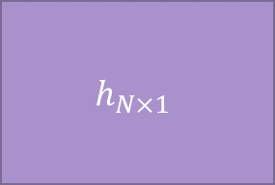

fastText
$$W_{M×N}$$
$$h_{N×1}$$
Input
x
=
$$M=MAX_VOCAB_SIZE=\text{30000000}+buck_size=\text{2000000}$$
N = dim

Slide 32
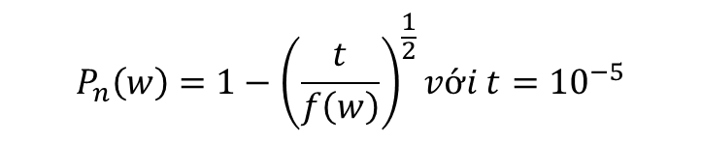
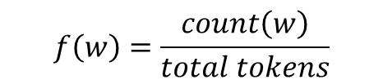

fastText
$$f\left(w\right)=\frac{count\left(w\right)}{total tokens}$$
$$P_{n}\left(w\right)=1−{\left(\frac{t}{f\left(w\right)}\right)}^{\frac{1}{2}}với t={10}^{−5}$$
(Theo: Tomas Mikolov, Ilya Sutskever, Kai Chen, Greg Corrado, Jeffrey Dean, Distributed Representations of Words and Phrases and their Compositionality)
$$P_{n}\left(w\right)=\frac{t}{f\left(w\right)}+{\left(\frac{t}{f\left(w\right)}\right)}^{\frac{1}{2}}$$
(Theo: fastText)

Slide 33
fastText

Slide 34

Glove

Slide 35

Glove

Slide 36


Slide 37


Slide 39


Slide 40

Glove(cost)

Slide 41

Elmo

Slide 42

Elmo

Slide 43


Slide 44


